Slide 1


Final Project Prensentation For IUT Laundry Management System
SPL II - SWE
Notes:
1

Slide 2
Team Members:
Tahmid Hafiz 230042136
Ibrahim Inyass 230042148
2
Notes:
2

Slide 3

Project Overview
  The Laundry Management System is designed to digitalize and improve the current manual process of handling garments in the university laundry. It aims to reduce errors such as lost or mixed-up clothes by introducing garment tracking, unique identification, and efficient process management from collection to delivery.
3
Notes:
3

Slide 4

Project Structure
  The project follows a modular, package-based structure, separating user management, laundry operations, and customer support to improve maintainability and code reuse.
Why?
  Users and access: Handles user roles, registration, authentication, and account approval.
  Laundry operations: Manages orders, garments, delivery, and rewash requests.
  Customer support and communication: Handles complaints, notifications, and application entry.
  Database and Maven: Centralize database configuration, table creation, and dependency management.
4
Notes:
4

Slide 5
Project Structure
IUT-Laundry-Management-System/
├── pom.xml
├── README.md
├── database/
│ └── schema.sql
└── src/
└── main/
└── java/
├── usersaccess/
│ ├── User.java
│ ├── Student.java
│ ├── Faculty.java
│ ├── LaundryManager.java
│ ├── LaundryStaff.java
│ ├── UserRole.java
│ ├── UserService.java
│ ├── UserRepository.java
│ ├── Database.java
│ └── PasswordUtil.java
├── laundryoperations/
│ ├── LaundryOrder.java
│ ├── Garment.java
│ ├── Delivery.java
│ ├── RewashRequest.java
│ ├── LaundryService.java
│ └── LaundryRepository.java
└── customersupportcommunication/
├── Main.java
├── Complaint.java
├── ComplaintRepository.java
├── Notification.java
└── NotificationService.java
5
Notes:
4

Slide 6
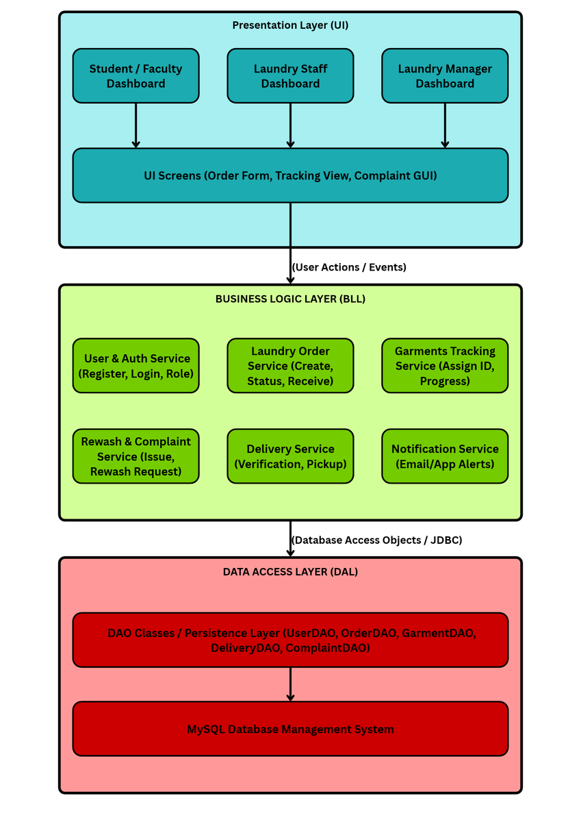
Communication between Components
6
Notes:
4

Slide 7
Communication between Components
Data exchanged between components
  Interface → Service: Java method arguments, such as user ID, order ID, garment details, and service type.
  Service → Model: Objects such as User, LaundryOrder, Garment, and Complaint.
  Repository → Database: SQL statements with JDBC PreparedStatement parameters.
  Database → Repository: ResultSet rows, converted into Java values or collections.
  Notifications: A recipient ID and message are stored in the database. Actual email or SMS delivery is not implemented.
End-to-end example: Creating a laundry order
  A student selects Create Order in Main.java.
  LaundryService.createOrder() receives the authenticated User and the selected DeliveryPreference.
  LaundryRepository.createOrder() generates an order ID and executes an SQL INSERT using JDBC.
  MySQL stores the order in laundry_orders, linked to the student through customer_id.
  The generated order ID is returned through the service to Main.java and displayed to the student.
7
Notes:
4

Slide 8
Division of Classes and Methods
Class Responsibilities and Design Rationale
Class Responsibility
User Defines shared user properties and behavior.
Student, Faculty, LaundryManager, LaundryStaff Extend User with role-specific information.
UserService Handles registration, login, and authentication rules.
UserRepository Performs user-related database queries.
LaundryService Applies laundry business rules and coordinates operations.
LaundryRepository Stores and retrieves laundry-related data.
ComplaintRepository Updates complaint status and resolution notes.
NotificationService Creates and stores notifications.
Main Provides the console menu and connects user input to services.
Design principles
  Single Responsibility Principle (SRP): Each class has a specific purpose.
  Separation of concerns: Business logic is separated from SQL operations and user interaction.
  Encapsulation: Models manage their own fields and expose appropriate methods.
  Inheritance: Specialized user classes reuse shared properties from User.
  Reusability: Services and repositories can be called by multiple parts of the application.
8
Notes:
4

Slide 9
Division of Classes and Methods
Maximum Class LoC
174
Maximum Class LoC
174
Average Class LoC
46.14
Maximum Class LoC
174
9
Notes:
4

Slide 10
Thank you
very much
Presented by:
Hafiz & Inyass
Notes:
7

